Slide 1
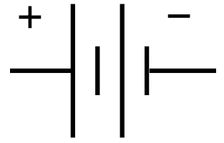
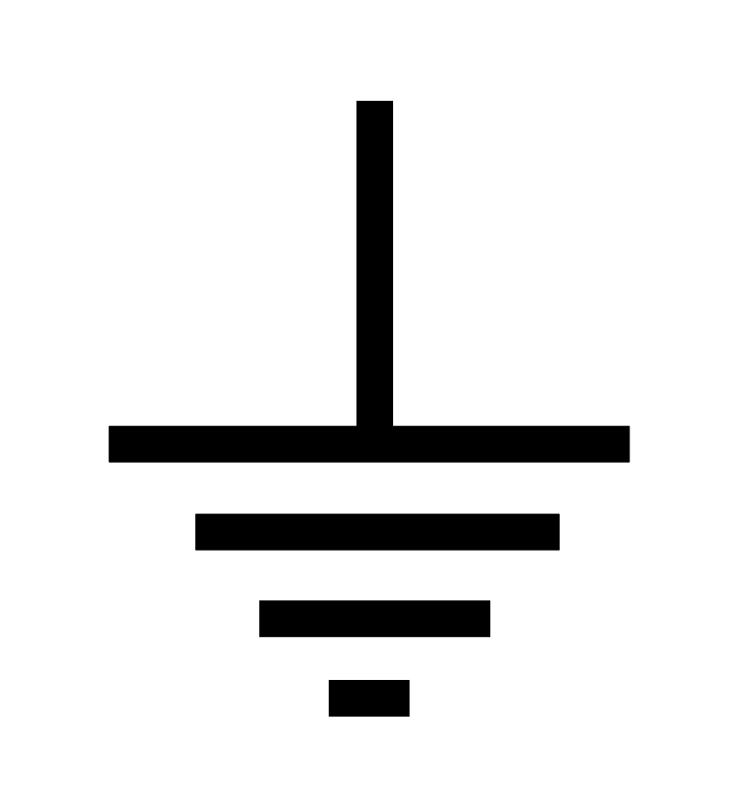
Audio Signal Amplifier
Air Column Resonator
Loudspeaker
Valve Actuator #1
Valve Actuator #2
Valve Actuator #3
CPU
Digital to Analog Converter (DAC)
Digital Fundamental Frequency Signal Synthesizer
Digital Actuator Position Controller
Power Transistor #3
Power Transistor #2
Power Transistor #1

Slide 2
Digital Signal
Analog Signal
Sound Signal
Mechanical Signal
DC Voltage Source – Positive Terminal
DC Voltage Source – Negative Terminal

